Slide 1
Voidrunner Echoes of darkness
Group Assignment 2

Slide 2
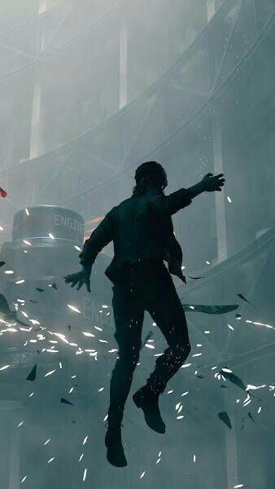
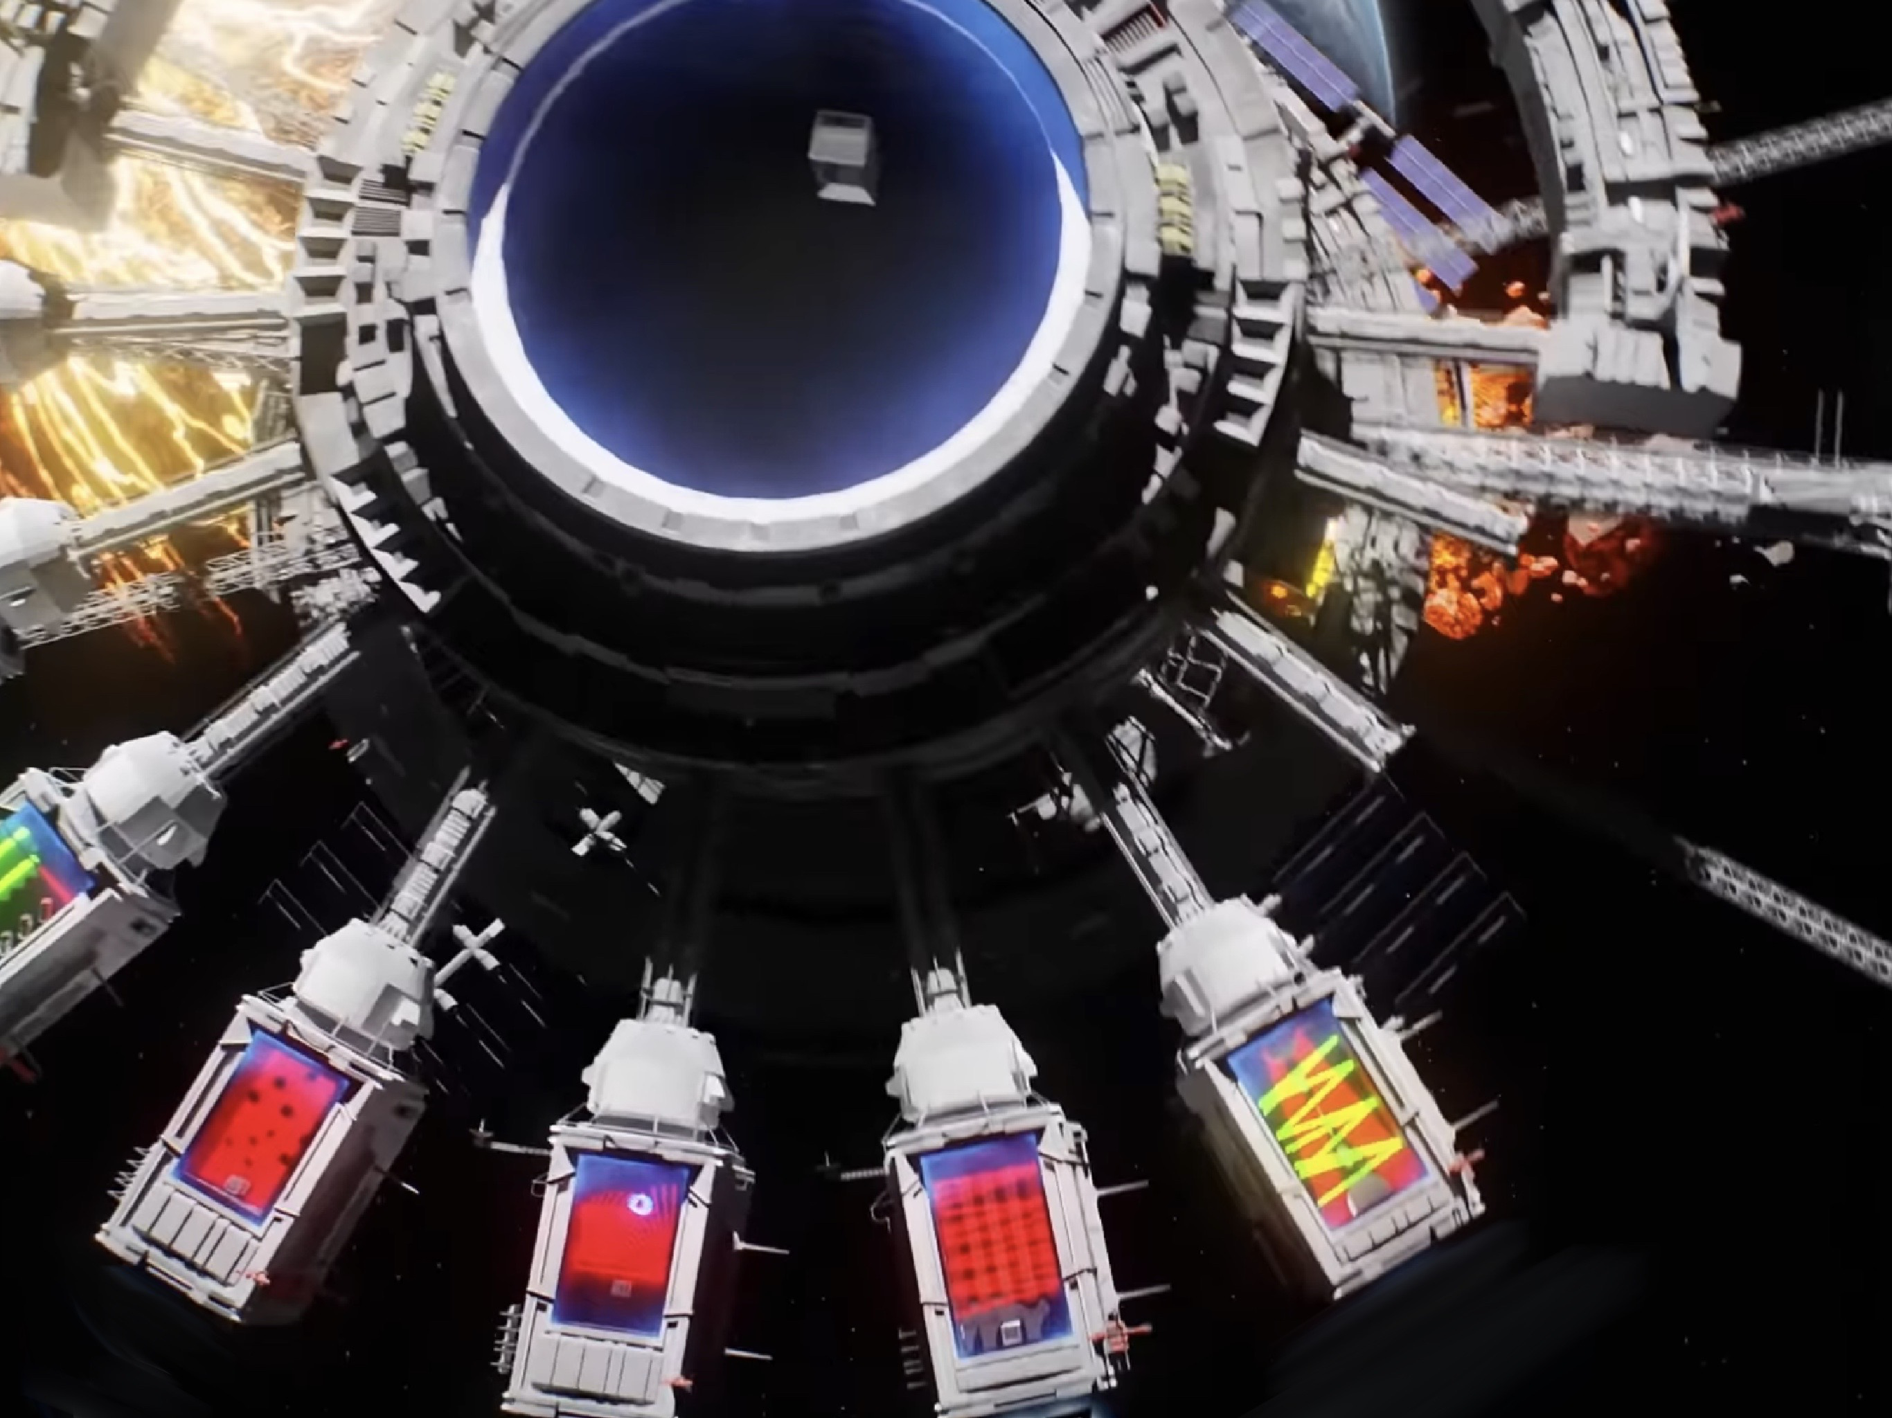

Overview
Genre
Setting
Characters
First-person Platformer
Sci-fi Spaceship
Cap 0 the cyborg, Black Crawlers,Void Crawlers.

Slide 3
Game overview
"Voidrunner: echoes of Darkness" is an intense first-person platformer set in the dark, in a floating spaceship.
Players take on the role of Cap 0, an elite cyborg to investigate and destroy the core of the ship. As Cap 0 explores the labyrinthine interior, discovers that the ship is infested with black, slimy creatures that can traverse walls and ceilings, making every surface a potential threat.

Slide 4
Story and exploration
Narrative: Destroy the ship's and escape from them.
Exploration: Non-linear exploration with multiple paths and secrets to discover. Some areas are only accessible with specific upgrades, encouraging replayability.
Atmosphere: The ship's environment is dark and foreboding, with flickering lights, ominous sounds, and eerie, organic growths that hint at the presence of the Void Crawlers.

Slide 5
Objective
Survive the horrors within the spaceship, uncover the Black Crawlers' presence, and find a way to eliminate the infestation and destroy the spaceship.
"Voidrunner: echoes of Darkness" aims to blend the thrill of first-person platforming with the tension of survival horror, offering players a unique and immersive experience in a sci-fi setting.

Slide 6
Game mechanics
01
02
03
Gravity manipulation
Environment unlocker
Movement and platforming
Gravity Manipulation: Certain sections allow players to manipulate gravity, enabling them to walk on walls or ceilings, adding a layer of complexity to platforming challenges.
The spaceship is riddled with hazards like malfunctioning doors, electrical discharges, and broken pathways requiring precise timing and agility to overcome.
Grapple : Equipped with an advanced grapple, players can double jump, perform mid-air dashes, and wall-run to navigate the ship's intricate architecture.

Slide 7
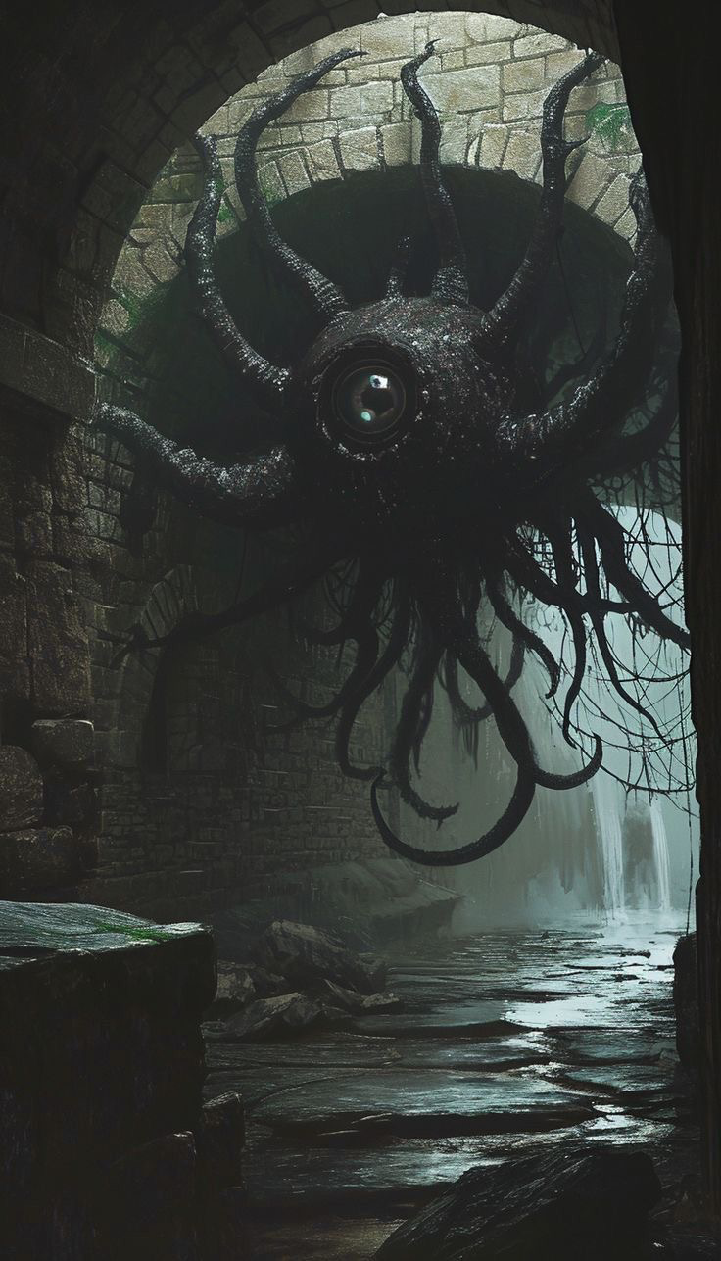

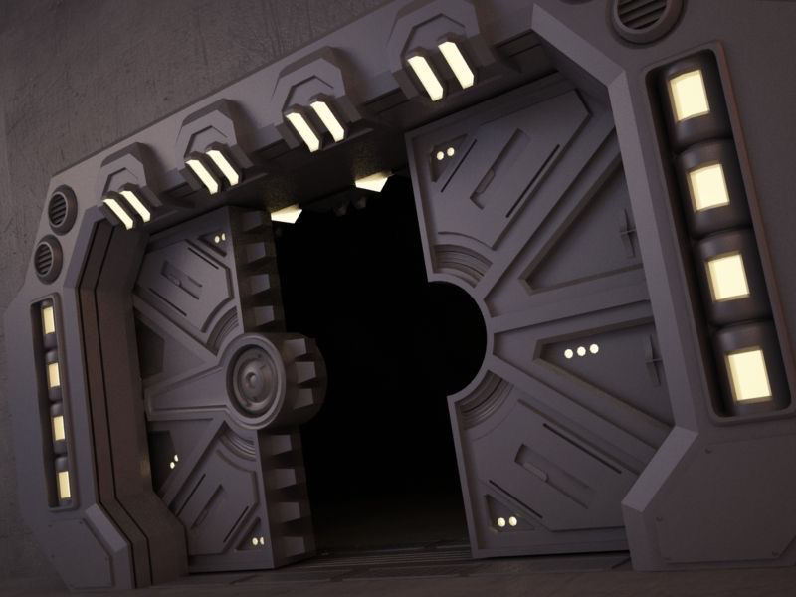
Enemies
Difficulty 30%
Difficulty 50%
Difficulty 70%
Black crawlers
These black, slimy creatures can cling to any surface. They are highly mobile and can ambush players from unexpected angles.
Environmental puzzles
Some areas require players to trigger traps or use environmental features to their advantage.
Void crawlers
Larger, more formidable enemies that control smaller Black Crawlers. Defeating them can temporarily pacify nearby creatures.

Slide 8
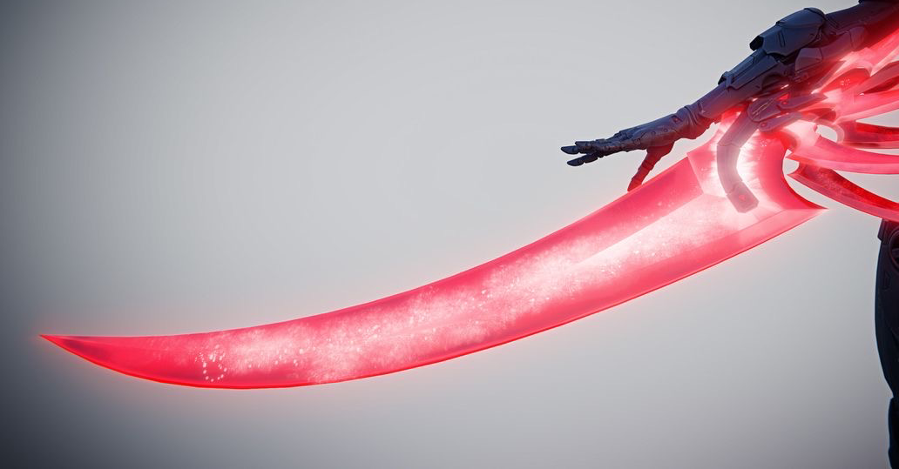
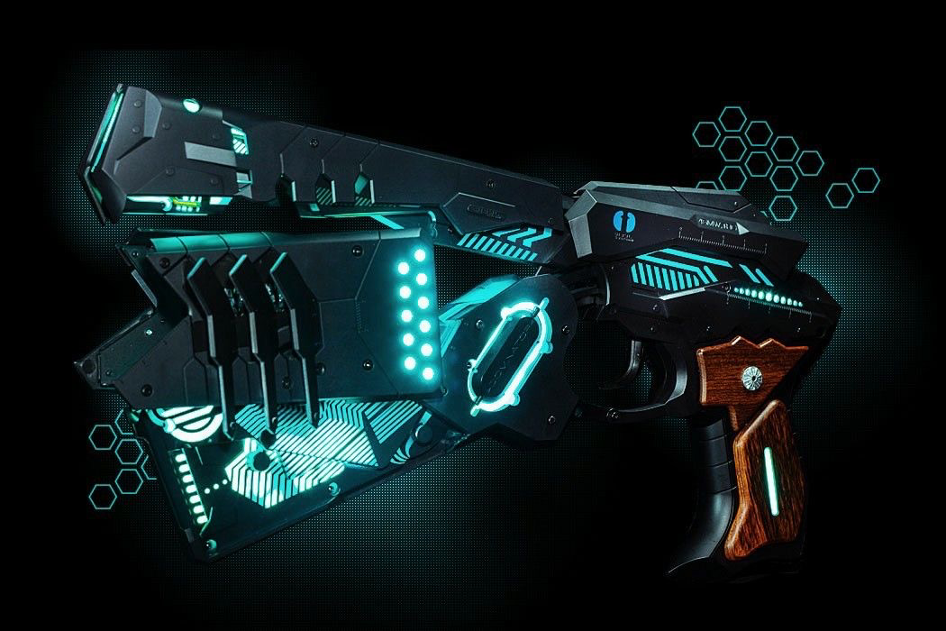
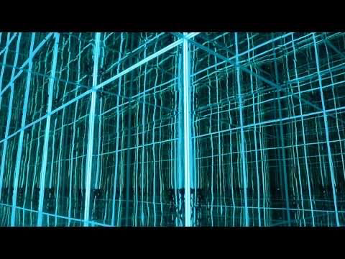
Tools and upgrades
 | Description
Plasma blade | A melee weapon for close-quarters combat, effective against the slimy creatures.
Blue blaster | A ranged weapon that can be upgraded with different modes (e.g., rapid fire, charged shots).
Scanner | A device to detect hidden puzzles in the environment

Slide 9
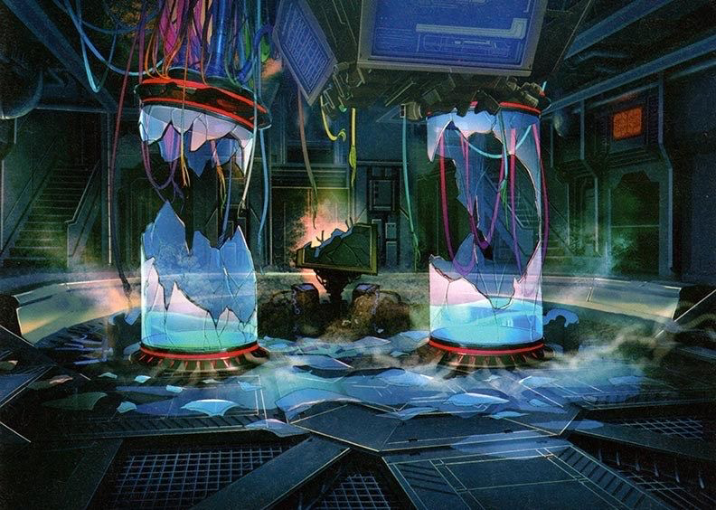
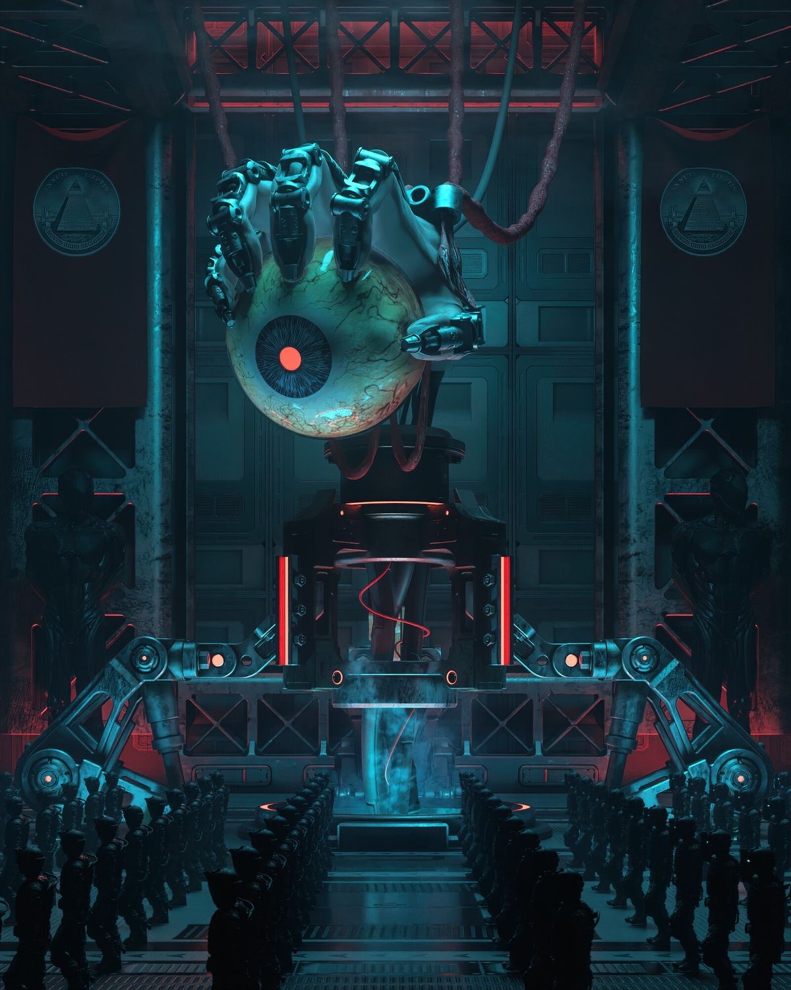
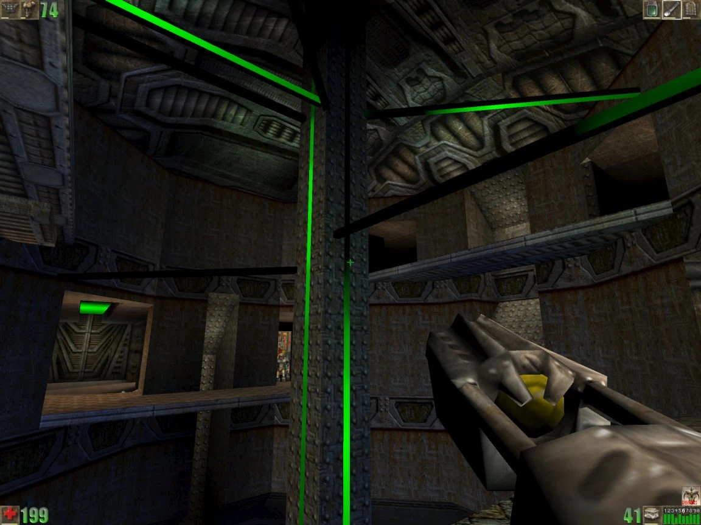
Visual style
Dark and futuristic
Dynamic lighting
Fogs and neon
The ship’s interior is a blend of sleek, futuristic design and decaying in some parts of the ship with organic corruption.
To add more of an ominous vibe to the setting and neon lights to give a sci-fi fee
Use of shadows and light to create tension and highlight the unpredictable nature of the enemies.

Slide 10
Sound design
Ambient sound
Music
The creaking of the ship, distant screeches, and the unsettling slithering of the creatures on walls.
A haunting, atmospheric soundtrack that intensifies during combat and critical platforming sequences.

Slide 11
Objective
Survive
Destroy
Survive the horrors within the spaceship, uncover the Black Crawlers' presence, and find a way to eliminate the infestation and destroy the spaceship.
Kill and discover the mastery behind the spaceship and destroy it.

Slide 12
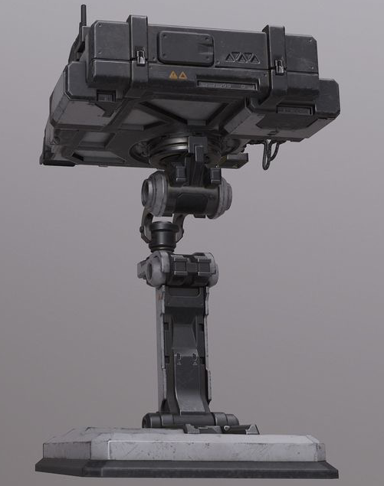
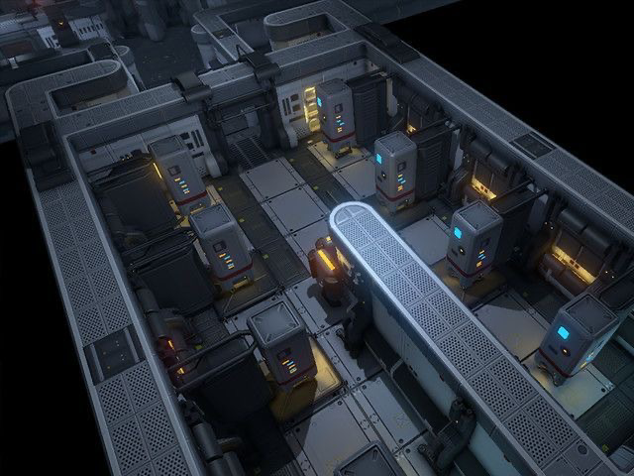
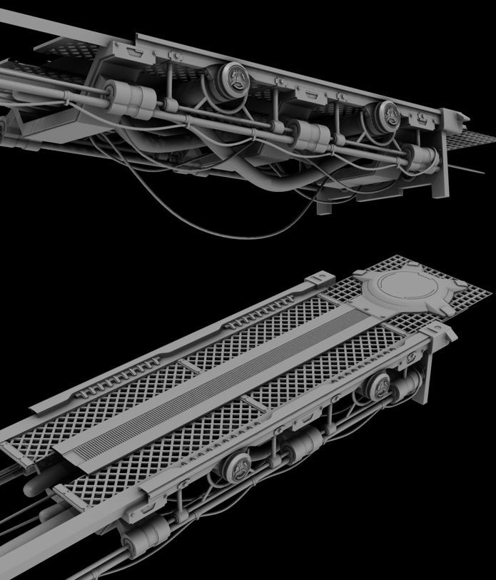
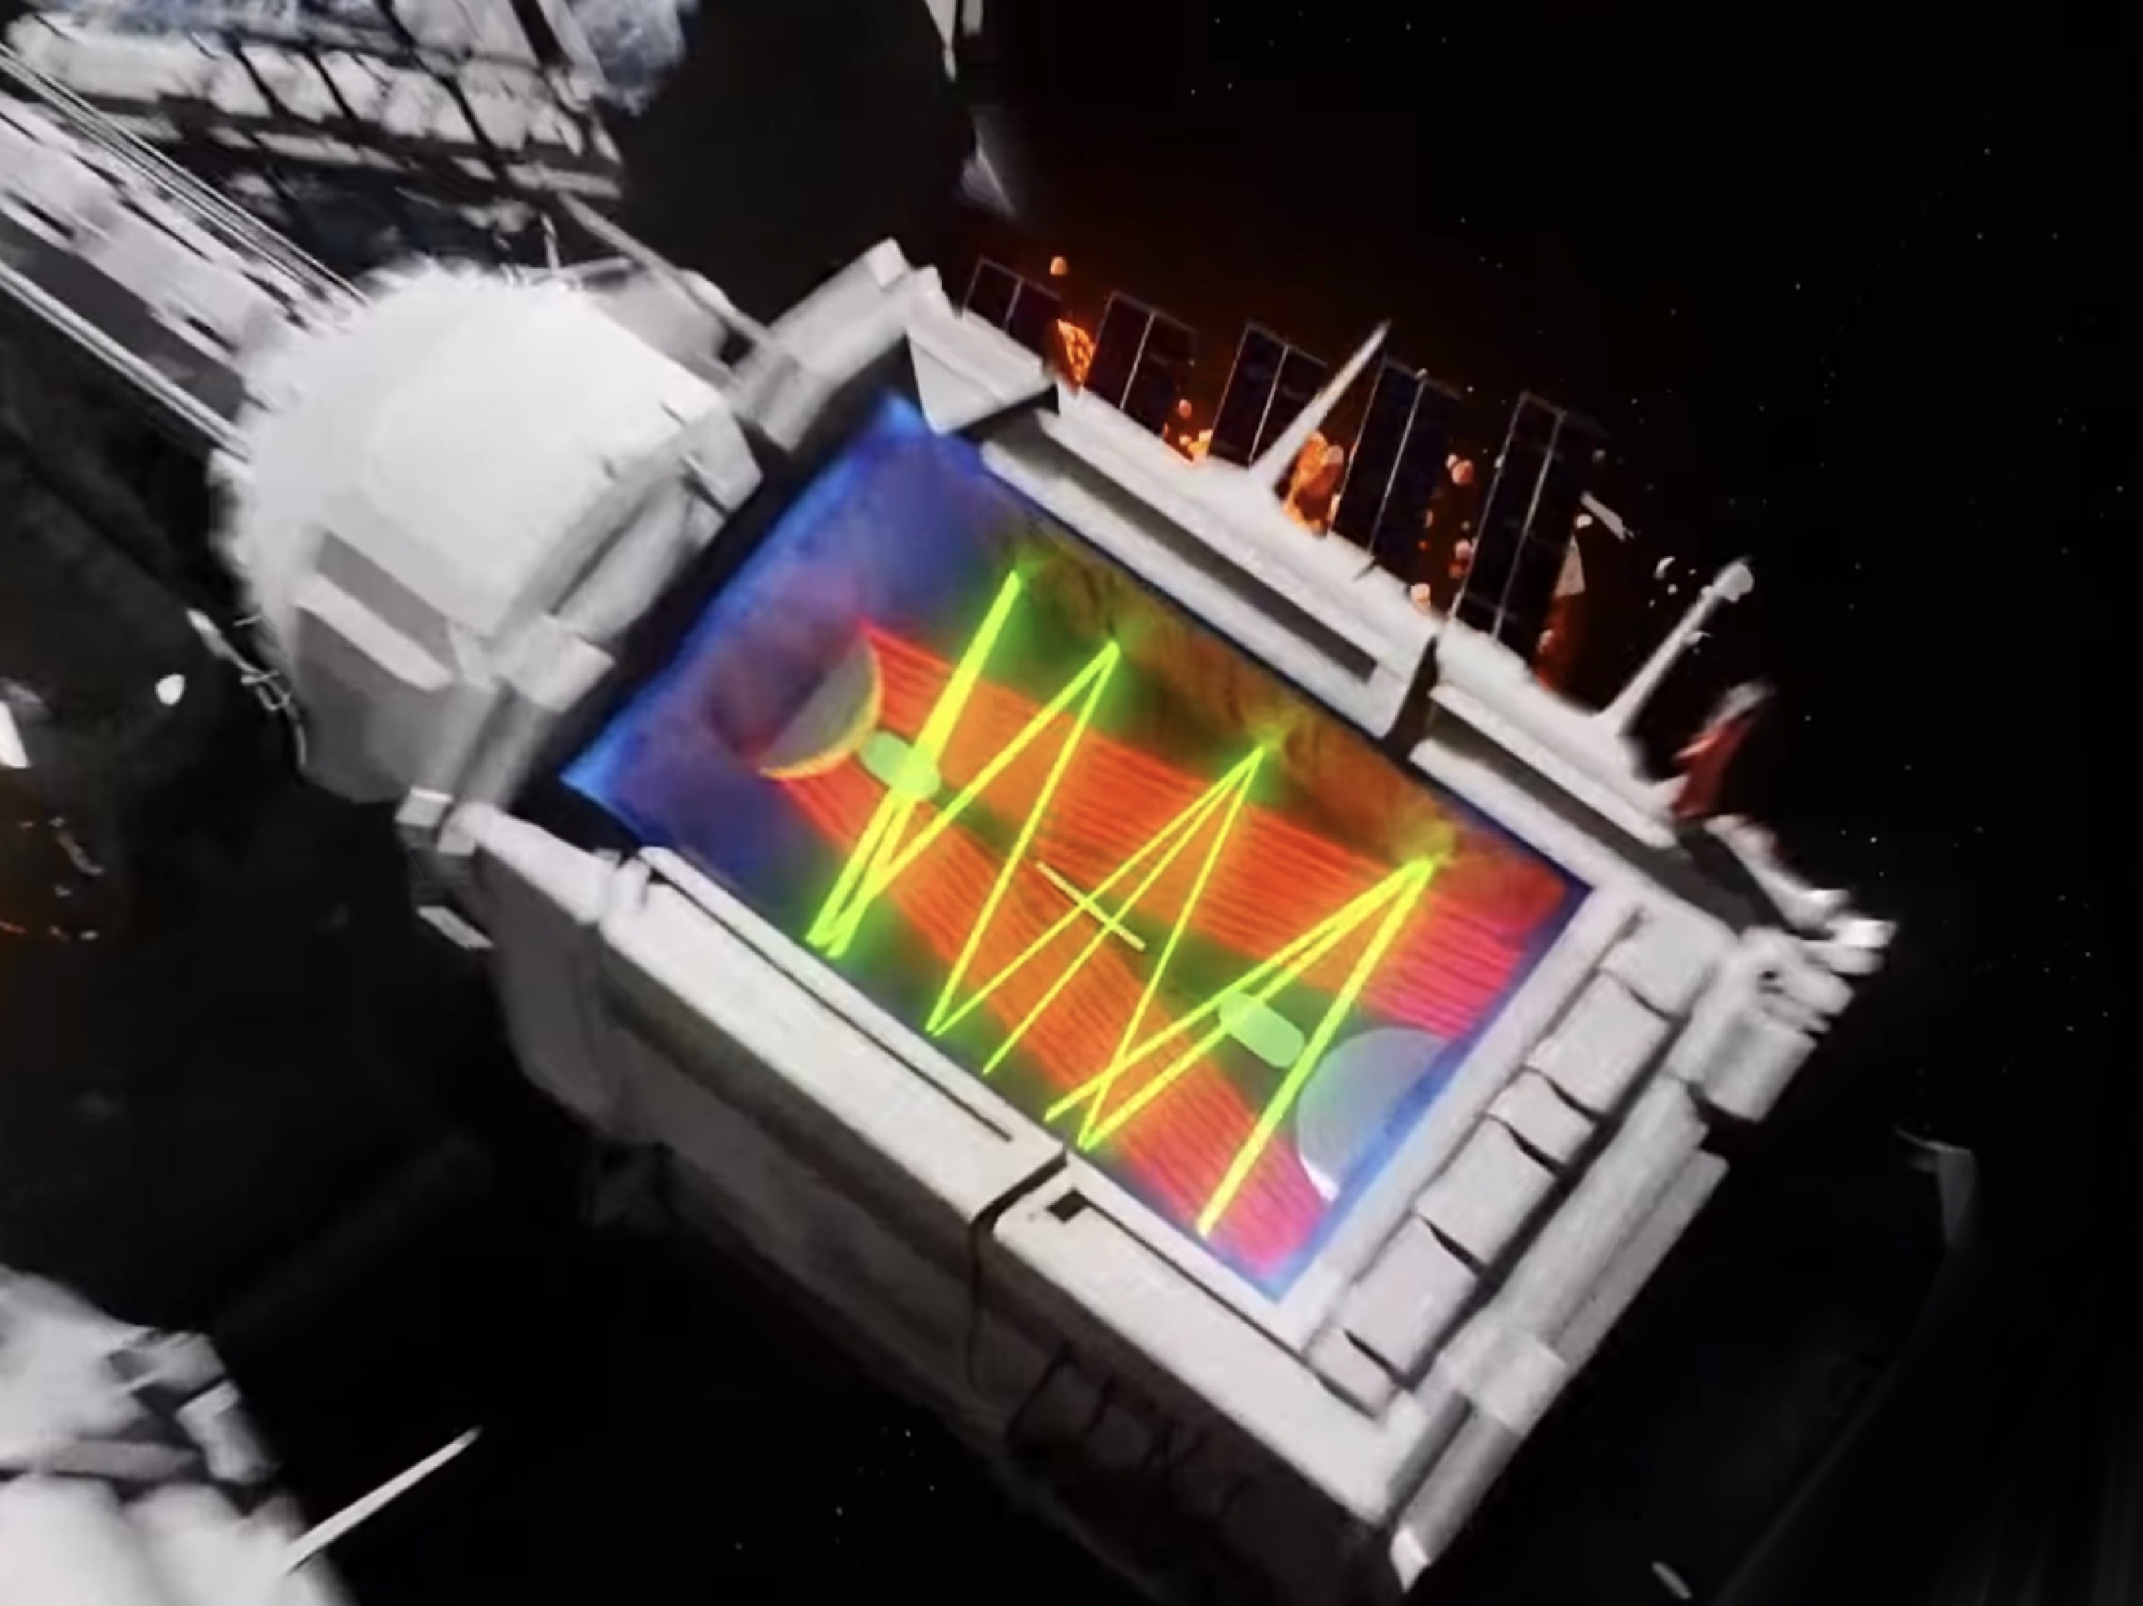
Obstacles
Moving platforms
Walls
The player has to to jump on moving platforms in different directions
The player have to jump over walls for go head
Pipes
Lasers
Jump and dodge the pipes
Avoid the laser long your way, exit from the laser maze

Slide 13
Thank you for listening !

